Slide 1
Chapter 2
Software Development Process Model

Slide 2
Program Development Methods
Waterfall Model
Evolutionary Development
Spiral Model
Iterative Model
Agile Model
RAD Model
Prototype or Transformation Model

Slide 3
Waterfall Model/Traditional Model
Waterfall is the oldest and most straightforward of the structured SDLC methodologies — finish one phase, then move on to the next.
No going back. Each stage relies on information from the previous stage and has its own project plan.
Waterfall is easy to understand and simple to manage.
But early delays can throw off the entire project timeline.
And since there is little room for revisions once a stage is completed, problems can’t be fixed until you get to the maintenance stage.
This model doesn’t work well if flexibility is needed or if the project is long term and ongoing.

Slide 4
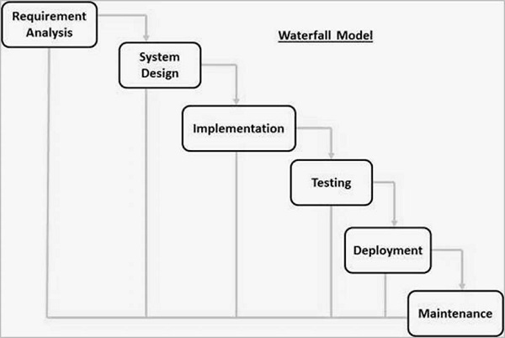
Waterfall Model

Slide 5
Sequential phases in Waterfall model
Requirement Gathering and analysis − All possible requirements of the system to be developed are captured in this phase and documented in a requirement specification document.

Slide 6
Sequential phases in Waterfall model
System Design − The requirement specifications from first phase are studied in this phase and the system design is prepared.
This system design helps in specifying hardware and system requirements and helps in defining the overall system architecture.

Slide 7
Sequential phases in Waterfall model
Implementation − With inputs from the system design, the system is first developed in small programs called units, which are integrated in the next phase.
Each unit is developed and tested for its functionality, which is referred to as Unit Testing.

Slide 8
Sequential phases in Waterfall model
Deployment of system − Once the functional and non-functional testing is done; the product is deployed in the customer environment or released into the market.
Maintenance − There are some issues which come up in the client environment. To fix those issues, patches are released.
Also to enhance the product some better versions are released. Maintenance is done to deliver these changes in the customer environment.

Slide 9
Applications
Requirements are very well documented, clear and fixed.
Product definition is stable.
Technology is understood and is not dynamic.
There are no ambiguous requirements.
Sample resources with required expertise are available to support the product.
The project is short.

Slide 10
Advantages
Simple and easy to understand and use
Phases are processed and completed one at a time.
Works well for smaller projects where requirements are very well understood.
Clearly defined stages.
Process and results are well documented.

Slide 11
Disadvantages
No working software is produced until late during the life cycle.
High amounts of risk and uncertainty.
Not a good model for complex and object-oriented projects.
Poor model for long and ongoing projects.
It is difficult to measure progress within stages.
Cannot accommodate changing requirements.

Slide 12
Prototype or Transformation Model
In this process model, the system is partially implemented before or during the analysis phase thereby giving the customers an opportunity to see the product early in the life cycle.
The process starts by interviewing the customers and developing the incomplete high-level paper model.
This document is used to build the initial prototype supporting only the basic functionality as desired by the customer.
Once the customer figures out the problems, the prototype is further refined to eliminate them.
The process continues until the user approves the prototype and finds the working model to be satisfactory.

Slide 13
Prototype or Transformation Model
Prototyping is defined as the process of developing a working replication of a product or system that has to be engineered.
It offers a small scale facsimile of the end product and is used for obtaining customer feedback as described below:

Slide 14
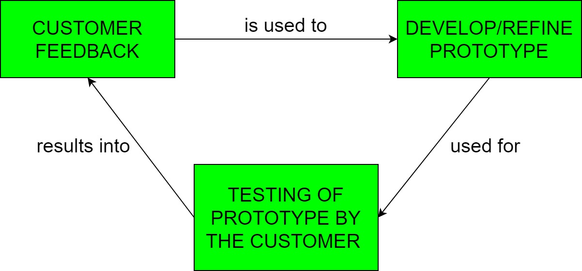
Prototype or Transformation Model

Slide 15
Prototype or Transformation Model
This model is used when the customers do not know the exact project requirements beforehand.
In this model, a prototype of the end product is first developed, tested and refined as per customer feedback repeatedly till a final acceptable prototype is achieved which forms the basis for developing the final product.

Slide 16
Prototype or Transformation Model
The time interval between the project begin and final delivery is substantially reduced because all parts of the system are prototyped and tested simultaneously.
Of course, there might be the possibility that the pieces just not fit together due to some lack ness in the development phase – this can only be fixed by careful and complete plotting of the entire system before prototyping starts.

Slide 17
Prototype or Transformation Model
There are four types of model available: A) Rapid Throwaway Prototyping
This technique offers a useful method of exploring ideas and getting customer feedback for each of them.
In this method, a developed prototype need not necessarily be a part of the ultimately accepted prototype.
Customer feedback helps in preventing unnecessary design faults and hence, the final prototype developed is of better quality.
Example: HTML mockup of website.

Slide 18
Prototype or Transformation Model
B) Evolutionary Prototyping
In this method, the prototype developed initially is incrementally refined on the basis of customer feedback till it finally gets accepted.
In comparison to Rapid Throwaway Prototyping, it offers a better approach which saves time as well as effort.
This is because developing a prototype from scratch for every iteration of the process can sometimes be very frustrating for the developers.
Moble apps’s multiple updated version.

Slide 19
Prototype or Transformation Model
C) Incremental Prototyping –
In this type of incremental Prototyping, the final expected product is broken into different small pieces of prototypes and being developed individually.
In the end, when all individual pieces are properly developed, then the different prototypes are collectively merged into a single final product in their predefined order.
It’s a very efficient approach that reduces the complexity of the development process, where the goal is divided into sub-parts and each sub-part is developed individually.
For example: E-commerce site payment module, product module, cart module, are developed separately and finally integrated

Slide 20
Prototype or Transformation Model
D) Extreme Prototyping –
This method is mainly used for web development. It is consists of three sequential independent phases:
D.1) In this phase a basic prototype with all the existing static pages are presented in the HTML format.
D.2) In the 2nd phase, Functional screens are made with a simulate data process using a prototype services layer.
D.3) This is the final step where all the services are implemented and associated with the final prototype.
Example: Banking web app
UI---mock API---Real API integrate

Slide 21
Advantages –
The customers get to see the partial product early in the life cycle, which ensures a greater level of customer satisfaction and comfort.
New requirements can be easily accommodated as there is scope for refinement.
Missing functionalities can be easily figured out.
Errors can be detected much earlier thereby saving a lot of effort and cost, besides enhancing the quality of the software.
The developed prototype can be reused by the developer for more complicated projects in the future.
Flexibility in design.

Slide 22
Disadvantages –
Costly w.r.t time as well as money.
There may be too much variation in requirements each time the prototype is evaluated by the customer.
It is very difficult for developers to accommodate all the changes demanded by the customer.
There is uncertainty in determining the number of iterations that would be required before the prototype is finally accepted by the customer.
After seeing an early prototype, the customers sometimes demand the actual product to be delivered soon.
Developers in a hurry to build prototypes may end up with sub-optimal solutions.
The customer might lose interest in the product if he/she is not satisfied with the initial prototype.

Slide 23
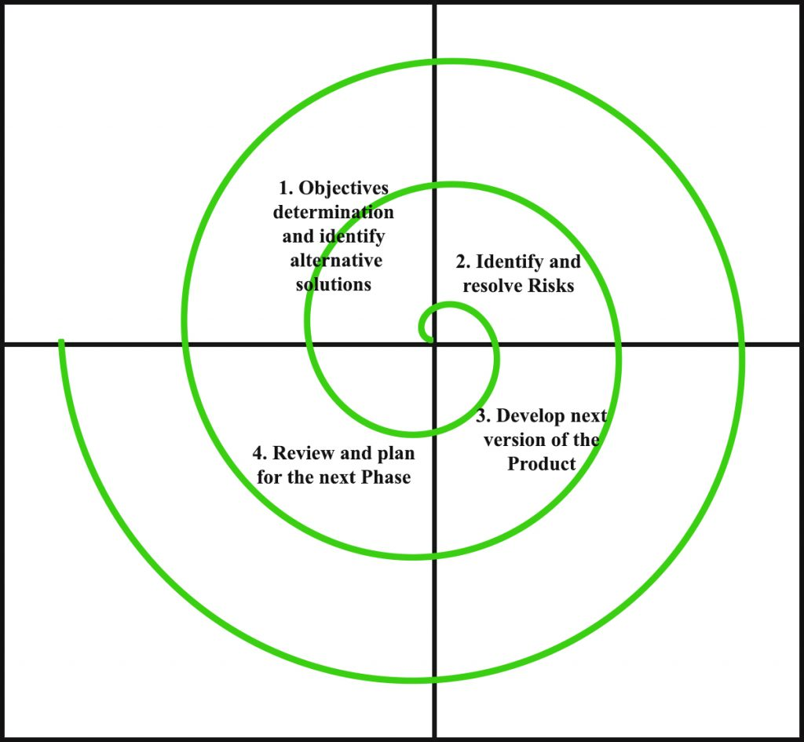
Spiral model

Slide 24
Spiral Model
Looks like a spiral with many loops.
Also called risk handling model
Number of loops of the spiral is unknown and can vary from project to project.
Each loop of the spiral is called a Phase of the software development process.

Slide 25
Spiral Model
The exact number of phases needed to develop the product can be varied by the project manager depending upon the project risks.
As the project manager dynamically determines the number of phases, so the project manager has an important role to develop a product using the spiral model.

Slide 26
Spiral Model
The Radius of the spiral at any point represents the expenses(cost) of the project
so far, and the angular dimension represents the progress made so far in the current phase.
Each loop of the spiral from x-axis clockwise through 360 degree represent one phase.
One phase is split roughly into four sectors of major activities.

Slide 27

Spiral Model

Slide 28
Phases of spiral model
Objectives determination and identify alternative solutions:
Requirements are gathered from the customers
Objectives are identified, elaborated, and analyzed at the start of every phase.
Then alternative solutions possible for the phase are proposed in this quadrant.

Slide 29
Phases of spiral model
Identify and resolve Risks:
During the second quadrant, all the possible solutions are evaluated to select the best possible solution.
Then the risks associated with that solution are identified and the risks are resolved using the best possible strategy.
At the end of this quadrant, the Prototype is built for the best possible solution.

Slide 30
Phases of spiral model
Develop next version of the Product:
During the third quadrant, the identified features are developed and verified through testing.
At the end of the third quadrant, the next version of the software is available.

Slide 31
Phases of spiral model
Review and plan for the next Phase:
In the fourth quadrant, the Customers evaluate the so far developed version of the software.
In the end, planning for the next phase is started.

Slide 32
Risk Handling in Spiral Model
A risk is any adverse situation that might affect the successful completion of a software project.
The most important feature of the spiral model is handling these unknown risks after the project has started.
Such risk resolutions are easier done by developing a prototype.
The spiral model supports coping up with risks by providing the scope to build a prototype at every phase of the software development.

Slide 33
Risk Handling in Spiral Model
The Prototyping Model also supports risk handling, but the risks must be identified completely before the start of the development work of the project.
But in real life project risk may occur after the development work starts, in that case, we cannot use the Prototyping Model.
In each phase of the Spiral Model, the features of the product dated and analyzed, and the risks at that point in time are identified and are resolved through prototyping.
Thus, this model is much more flexible compared to other SDLC models.

Slide 34
Why Spiral Model is called Meta Model?
The Spiral model is called a Meta-Model because it subsumes all the other SDLC models.
For example, a single loop spiral actually represents the Iterative Waterfall Model.
The spiral model incorporates the stepwise approach of the Classical Waterfall Model.

Slide 35
Why Spiral Model is called Meta Model?
The spiral model uses the approach of the Prototyping Model by building a prototype at the start of each phase as a risk-handling technique.
Also, the spiral model can be considered as supporting the evolutionary model – the iterations along the spiral can be considered as evolutionary levels through which the complete system is built.

Slide 36
Advantages of Spiral Model:
Risk Handling: The projects with many unknown risks that occur as the development proceeds, in that case, Spiral Model is the best development model to follow due to the risk analysis and risk handling at every phase.
Good for large projects: It is recommended to use the Spiral Model in large and complex projects.
Flexibility in Requirements: Change requests in the Requirements at later phase can be incorporated accurately by using this model.
Customer Satisfaction: Customer can see the development of the product at the early phase of the software development and thus, they habituated with the system by using it before completion of the total product.

Slide 37
Disadvantages of Spiral Model:
Complex: The Spiral Model is much more complex than other SDLC models.
Expensive: Spiral Model is not suitable for small projects as it is expensive.
Too much dependability on Risk Analysis: The successful completion of the project is very much dependent on Risk Analysis. Without very highly experienced experts, it is going to be a failure to develop a project using this model.
Difficulty in time management: As the number of phases is unknown at the start of the project, so time estimation is very difficult.

Slide 38
Iterative Model
Iterative process starts with a simple implementation of a subset of the software requirements and iteratively enhances the evolving versions until the full system is implemented.
At each iteration, design modifications are made and new functional capabilities are added.
The basic idea behind this method is to develop a system through repeated cycles (iterative) and in smaller portions at a time (incremental).

Slide 39
Iterative Model
Iterative and Incremental development is a combination of both iterative design or iterative method and incremental build model for development.
"During software development, more than one iteration of the software development cycle may be in progress at the same time."
This process may be described as an "evolutionary acquisition" or "incremental build" approach."

Slide 40
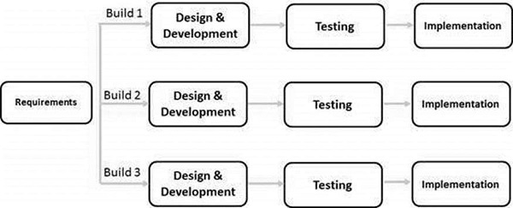
Iterative Model

Slide 41
Iterative Model
In this incremental model, the whole requirement is divided into various builds.
During each iteration, the development module goes through the requirements, design, implementation and testing phases.
Each subsequent release of the module adds function to the previous release.
The process continues till the complete system is ready as per the requirement.

Slide 42
Iterative Model
The key to a successful use of an iterative software development lifecycle is rigorous validation of requirements, verification & testing of each version of the software against those requirements within each cycle of the model.
As the software evolves through successive cycles, tests must be repeated and extended to verify each version of the software.

Slide 43
Application
Like other SDLC models, Iterative and incremental development has some specific applications in the software industry. This model is most often used in the following scenarios −
Requirements of the complete system are clearly defined and understood.
Major requirements must be defined; however, some functionalities or requested enhancements may evolve with time.

Slide 44
Advantages
Some working functionality can be developed quickly and early in the life cycle.
Results are obtained early and periodically.
Parallel development can be planned.
Progress can be measured.
Less costly to change the scope/requirements.
Testing and debugging during smaller iteration is easy.
Risks are identified and resolved during iteration; and each iteration is an easily managed milestone.
Easier to manage risk - High risk part is done first.

Slide 45
Rapid Application Development(RAD Model)
Based on prototyping and iterative development with no specific planning involved.
Product can be developed faster and higher quality.
Gathering customer requirements through workshops or focus groups.
Early testing of the prototypes by the customer using iterative concept.
Reuse of software components

Slide 46
Rapid Application Development(RAD Model)
Uses minimal planning in favor of rapid prototyping
The functional modules are developed in parallel as prototypes
Integrated to make the complete product for faster product delivery
RAD model distributes the analysis, design, build and test phases into a series of short, iterative development cycles

Slide 47
RAD Model Phases
Business Modelling
The business model for the product under development is designed in terms of flow of information and the distribution of information between various business channels.
A complete business analysis is performed to find the vital information for business,
How it can be obtained
How and when is the information processed
What are the factors driving successful flow of information.

Slide 48
RAD Model Phases
Data Modelling
The information gathered in the Business Modelling phase is reviewed and analyzed to form sets of data objects vital for the business.
The attributes of all data sets is identified and defined.
The relation between these data objects are established and defined in detail in relevance to the business model.

Slide 49
RAD Model Phases
Process Modelling
The data object sets defined in the Data Modelling phase are converted to establish the business information flow needed to achieve specific business objectives as per the business model.
The process model for any changes or enhancements to the data object sets is defined in this phase.
Process descriptions for adding, deleting, retrieving or modifying a data object are given.

Slide 50
RAD Model Phases
Application Generation
The actual system is built and coding is done by using automation tools to convert process and data models into actual prototypes.

Slide 51
RAD Model Phases
Testing and Turnover
The overall testing time is reduced in the RAD model as the prototypes are independently tested during every iteration.
However, the data flow and the interfaces between all the components need to be thoroughly tested with complete test coverage.
Since most of the programming components have already been tested, it reduces the risk of any major issues.

Slide 52
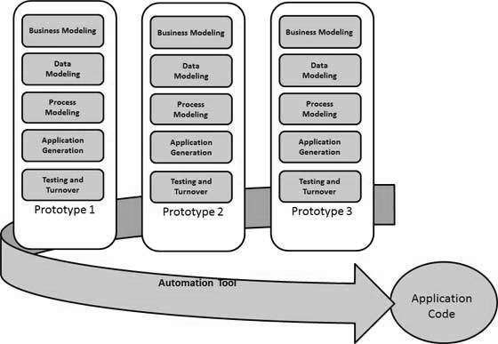
RAD Model

Slide 53
RAD Model Vs. Traditional SDLC
The traditional SDLC follows a rigid process models with high emphasis on requirement analysis and gathering before the coding starts.
It puts pressure on the customer to sign off the requirements before the project starts and the customer doesn’t get the feel of the product as there is no working build available for a long time.
The customer may need some changes after he gets to see the software.

Slide 54
RAD Model Vs. Traditional SDLC
However, the change process is quite rigid and it may not be feasible to incorporate major changes in the product in the traditional SDLC.
The RAD model focuses on iterative and incremental delivery of working models to the customer.
This results in rapid delivery to the customer and customer involvement during the complete development cycle of product reducing the risk of non-conformance with the actual user requirements.

Slide 55
RAD Model - Application
RAD model can be applied successfully to the projects in which clear modularization is possible.
RAD should be used only when a system can be modularized to be delivered in an incremental manner.
It should be used if there is a high availability of designers for Modelling.
It should be used only if the budget permits use of automated code generating tools.
RAD SDLC model should be chosen only if domain experts are available with relevant business knowledge.
Should be used where the requirements change during the project and working prototypes are to be presented to customer in small iterations of 2-3 months.

Slide 56
Advantages of the RAD Model
Changing requirements can be accommodated.
Progress can be measured.
Iteration time can be short with use of powerful RAD tools.
Productivity with fewer people in a short time.
Reduced development time.
Increases reusability of components.
Quick initial reviews occur.
Encourages customer feedback.
Integration from very beginning solves a lot of integration issues.

Slide 57
Disadvantages of the RAD Model
Dependency on technically strong team members for identifying business requirements.
Only system that can be modularized can be built using RAD.
Requires highly skilled developers/designers.
High dependency on Modelling skills.
Inapplicable to cheaper projects as cost of Modelling and automated code generation is very high.
Management complexity is more.
Suitable for systems that are component based and scalable.
Requires user involvement throughout the life cycle.
Suitable for project requiring shorter development times.

Slide 58
Rational Unified Process
Software development process for object-oriented models.
It is created by Rational software Corporation, a division of IBM.
It is designed and documented using UML (Unified Modeling Language).
Some characteristics of RUP are:
Use-case Driven,
Iterative,
Incremental,
Delivered Online Using Web Technology,
Customized Or Tailored In Modular And Electronic Form.
RUP reduces unexpected development costs and prevents the wastage of resources.

Slide 59
Phases of RUP
Inception
Elaboration
Construction
Transition
Production

Slide 60
Inception
Communication and planning
Identifies the scope of the project using a use-case model
Allows managers to estimate costs and time required.
Customers’ requirements are identified which makes and easy to make a plan for the project.
The project plan, Project goal, risks, use-case model, and Project description, are made.
The project is checked against the milestone criteria
if it couldn’t pass these criteria then the project can be either canceled or redesigned.

Slide 61
Elaboration
Planning and modeling
A detailed evaluation and development plan is carried out and diminishes the risks.
Revise or redefine the use-case model (approx. 80%), business case, and risks.
Again, checked against milestone criteria and if it couldn’t pass these criteria then again project can be canceled or redesigned.
Executable architecture baseline

Slide 62
Construction
The project is developed and completed.
System or source code is created and then testing is done.
Coding takes place.

Slide 63
Transition
The final project is released to the public.
Transit the project from development into production.
Update project documentation.
Beta testing is conducted.
Defects are removed from the project based on feedback from the public.

Slide 64
Production
The final phase of the model.
The project is maintained and updated accordingly.

Slide 65
Advantages of Rational Unified Process (RUP)
RUP provides good documentation, it completes the process in itself.
RUP provides risk-management support.
RUP reuses the components, and hence total time duration is less.
Good online support is available in the form of tutorials and training.

Slide 66
Disadvantages of Rational Unified Process (RUP)
Team of expert professional is required, as the process is complex.
Complex and not properly organized process.
More dependency on risk management.
Hard to integrate again and again.

Slide 67
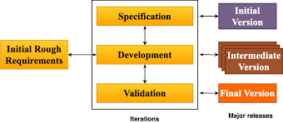
Evolutionary Model

Slide 68
Application of Evolutionary Model
It is used in large projects where you can easily find modules for incremental implementation.
Commonly used when the customer wants to start using the core features instead of waiting for the full software.
Used in object oriented software development because the system can be easily portioned into units in terms of objects.

Slide 69
Component Based software Engineering
A process that focuses on the design and development of computer-based systems with the use of reusable software components.
It identifies candidate components ,qualifies each component’s interface, adapts components to remove architectural mismatches, assembles components into a selected architectural style, and updates components as requirements for the system change.

Slide 70
Basic Principle of Component-Based Software Engineering
Reusability − Components are usually designed to be reused in different situations in different applications.
Replaceable − Components may be freely substituted with other similar components.
Not context specific − Components are designed to operate in different environments and contexts.
Extensible − A component can be extended from existing components to provide new behavior.
Encapsulated − A component depicts the interfaces, which allow the caller to use its functionality, and do not expose details of the internal processes or any internal variables or state.
Independent − Components are designed to have minimal dependencies on other components.

Slide 71
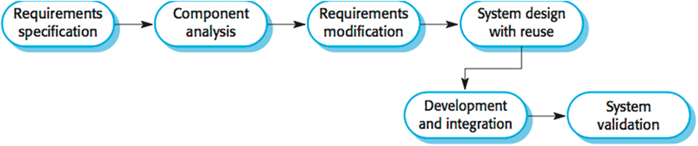
Reuse oriented model

Slide 72
Advantages
It can reduce total cost of software development.
The risk factor is very low.
It can save lots of time and effort.
It is very efficient in nature.

Slide 73
Disadvantages
Reuse-oriented model is not always worked as a practice in its true form.
Compromises in requirements may lead to a system that does not fulfill requirement of user.
Sometimes using old system component, that is not compatible with new version of component, this may lead to an impact on system evolution.

Slide 74
Computer aided software engineering (CASE)
CASE is the implementation of computer facilitated tools and methods in software development.
Ensure a high-quality and defect-free software.
Ensures a check-pointed and disciplined approach and helps designers, developers, testers, managers and others to see the project milestones during development.
CASE can also help as a warehouse for documents related to projects, like business plans, requirements and design specifications.
One of the major advantages of using CASE is the delivery of the final product, which is more likely to meet real-world requirements as it ensures that customers remain part of the process.

Slide 75
Computer aided software engineering (CASE)
CASE illustrates a wide set of labor-saving tools that are used in software development.
It generates a framework for organizing projects and to be helpful in enhancing productivity.
There was more interest in the concept of CASE tools years ago, but less so today, as the tools have morphed into different functions, often in reaction to software developer needs.

Slide 76
CASE Tools
The essential idea of CASE tools is that in-built programs can help analyze developing systems to enhance quality and provide better outcomes.
Throughout 1990, CASE tools became part of the software lexicon, and big companies like IBM were using these kinds of tools to help create software.
Various tools are incorporated in CASE and are called CASE tools, which are used to support different stages and milestones in a software development life cycle.

Slide 77
Types of CASE Tools
Diagramming Tools:
It helps in diagrammatic and graphical representations of the data and system processes.
It represents system elements, control flow and data flow among different software components and system structure in a pictorial form. For example, Flow Chart Maker tool for making state-of-the-art flowcharts.

Slide 78
Types of CASE Tools
2. Computer Display and Report Generators: It helps in understanding the data requirements and the relationships involved.
3. Analysis Tools: It focuses on inconsistent, incorrect specifications involved in the diagram and data flow.
It helps in collecting requirements, automatically check for any irregularity, imprecision in the diagrams, data redundancies or erroneous omissions. For example,
(i) Accept 360, Accompa, CaseComplete for requirement analysis.
ii) Visible Analyst for total analysis.

Slide 79
Types of CASE Tools:
4. Central Repository: It provides the single point of storage for data diagrams, reports and documents related to project management.
5. Documentation Generators: It helps in generating user and technical documentation as per standards. It creates documents for technical users and end users. For example, Doxygen, DrExplain, Adobe RoboHelp for documentation.
6. Code Generators: It aids in the auto generation of code, including definitions, with the help of the designs, documents and diagrams.

Slide 80
Advantages of the CASE
As special emphasis is placed on redesign as well as testing, the servicing cost of a product over its expected lifetime is considerably reduced.
The overall quality of the product is improved as an organized approach is undertaken during the process of development.
Chances to meet real-world requirements are more likely and easier with a computer-aided software engineering approach.
CASE indirectly provides an organization with a competitive advantage by helping ensure the development of high-quality products.

Slide 81
Disadvantages of the CASE approach:
Cost: Using case tool is a very costly. Mostly firms engaged in software development on a small scale do not invest in CASE tools because they think that the benefit of CASE are justifiable only in the development of large systems.
Learning Curve: In most cases, programmers productivity may fall in the initial phase of implementation , because user need time to learn the technology. Many consultants offer training and on-site services that can be important to accelerate the learning curve and to the development and use of the CASE tools.
Tool Mix: It is important to build an appropriate selection tool mix to urge cost advantage CASE integration and data integration across all platforms is extremely important.

